Slide 1
Cryptography and Network Security
Chapter 10
Key Management Deffie Helman
Notes:
Lecture slides by Lawrie Brown for “Cryptography and Network Security”, 4/e, by William Stallings, Chapter 10 – “Key Management; Other Public Key Cryptosystems”.

Slide 2
Diffie-Hellman Key Exchange
first public-key type scheme proposed
by Diffie & Hellman in 1976 along with the exposition of public key concepts
  note: now know that Williamson (UK CESG) secretly proposed the concept in 1970
is a practical method for public exchange of a secret key
used in a number of commercial products
Notes:
The idea of public key schemes, and the first practical scheme, which was for key distribution only, was published in 1977 by Diffie & Hellman. The concept had been previously described in a classified report in 1970 by Williamson (UK CESG) - and subsequently declassified in 1987, see [ELLI99].

Slide 3
Diffie-Hellman Key Exchange
First PKC offered by Diffie and Hellman in 1976
still in commercial use
purpose is secure key-exchange
  actually key “agreement”
  both parties agree on a session key without releasing this key to a third party
    to be used for further communication using symmetric crypto
Security is in the hardness of the discrete logarithm problem
  given a^{b} mod n, a and n, it is computationally infeasible to find out b if n is large enough prime number

Slide 4
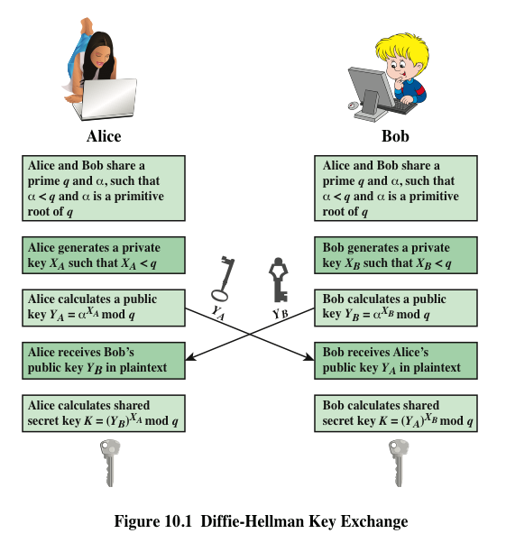
D-H Key Exchange
Y_{A} : A’s public key
X_{A} : A’s private key
Y_{B} : B’s public key
X_{B} : B’s private key
Notes:
q and α are known by both A and B beforehand. q is a prime number, α < q and α is a primitive root of q
Def’n of primitive root: α¹, α², α³, … , α^{q-1} (mod q) must be all distinct and between 1 and q-1
e.g. α=10, q=19.

Slide 5
D-H Key Exchange – PK Management
Two issues
  should we use global parameters (α and q) fixed for all public keys or unique?
  do we need to make sure that a particular public key Y_{i} produced by i?
In practice global parameters (α and q) are tied to Y values (public keys). However,
  both parties should use the same α and q, and
  there is no harm to use fixed α and q for all.
If the D-H public values are anonymous, then a man-in-the-middle attack is possible

Slide 6
D-H Key Exchange – PK Management
One PK management method
  a closed group share common global parameters (α and q)
  all users pick random secret values (X) and calculate corresponding public values (Y)
  Y’s are published at a trusted database
  when B wants to create a key for A
    B gets A’s public value Y_{A}, and calculates the session key
    A does the same when B sends an encrypted message to it
  However this method is not practical for distributed applications

Slide 7
D-H Key Exchange – PK Management
Anonymous public values are problematic
  causes man-in-the-middle attacks
  Attacker replaces the Y values with Y’ values for which it knows the corresponding X’ values
    at the end A and B generate different sessions keys that are also known by the attacker
    both A and B presume that other party has the same key, but this is not the case
  Solution: public values and parameters should be either known or should be endorsed by a trusted entity
    previous example of trusted database is one solution
    public key certificates are the most common solution

Slide 8
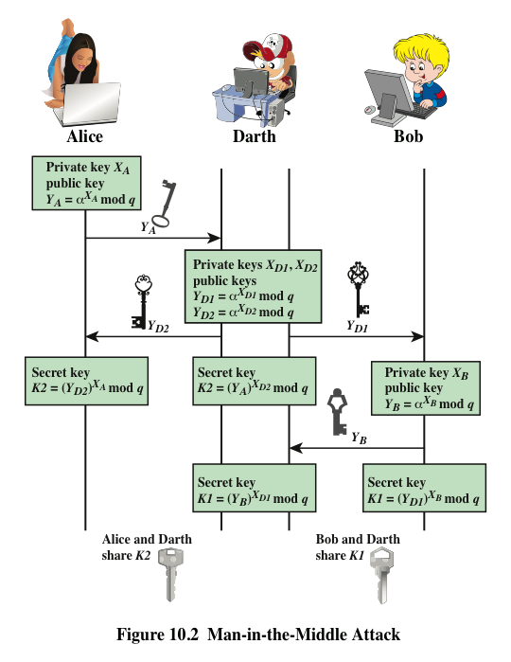

Slide 9
PKC - Remained
How to use RSA for digital signatures?
DSA / DSS
  Digital Signature Algorithm / Standard
Elliptic Curve Cryptography (ECC)
  ECDSA – Elliptic Curve DSA
  ECDH – Elliptic Curve D-H
First we will see hash functions
  several application areas

Slide 10
Diffie-Hellman Key Exchange
a public-key distribution scheme
  cannot be used to exchange an arbitrary message
  rather it can establish a common key
  known only to the two participants
value of key depends on the participants (and their private and public key information)
based on exponentiation in a finite (Galois) field (modulo a prime or a polynomial) - easy
security relies on the difficulty of computing discrete logarithms (similar to factoring) – hard
Notes:
The purpose of the algorithm is to enable two users to securely exchange a key that can then be used for subsequent encryption of messages. The algorithm itself is limited to the exchange of secret values, which depends on the value of the public/private keys of the participants. The Diffie-Hellman algorithm uses exponentiation in a finite (Galois) field (modulo a prime or a polynomial), and depends for its effectiveness on the difficulty of computing discrete logarithms.

Slide 11
Diffie-Hellman Setup
all users agree on global parameters:
  large prime integer or polynomial q
  a being a primitive root mod q
each user (eg. A) generates their key
  chooses a secret key (number): x_{A} < q
  compute their public key: y_{A} = a^{xA} mod q
each user makes public that key y_{A}
Notes:
In the Diffie-Hellman key exchange algorithm, there are two publicly known numbers: a prime number q and an integer a that is a primitive root of q. The prime q and primitive root a can be common to all using some instance of the D-H scheme. Note that the primitive root a is a number whose powers successively generate all the elements mod q. Users Alice and Bob choose random secrets x's, and then "protect" them using exponentiation to create their public y's. For an attacker monitoring the exchange of the y's to recover either of the x's, they'd need to solve the discrete logarithm problem, which is hard.

Slide 12
Diffie-Hellman Key Exchange
shared session key for users A & B is K_{AB}:
  K_{AB} = a^{xA.xB} mod q
  = y_{A}^{xB} mod q (which B can compute)
  = y_{B}^{xA} mod q (which A can compute)
K_{AB} is used as session key in private-key encryption scheme between Alice and Bob
if Alice and Bob subsequently communicate, they will have the same key as before, unless they choose new public-keys
attacker needs an x, must solve discrete log
Notes:
The actual key exchange for either party consists of raising the others "public key' to power of their private key. The resulting number (or as much of as is necessary) is used as the key for a block cipher or other private key scheme. For an attacker to obtain the same value they need at least one of the secret numbers, which means solving a discrete log, which is computationally infeasible given large enough numbers. Note that if Alice and Bob subsequently communicate, they will have the same key as before, unless they choose new public-keys.

Slide 13
Diffie-Hellman Example
users Alice & Bob who wish to swap keys:
agree on prime q=353 and a=3
select random secret keys:
  A chooses x_{A}=97, B chooses x_{B}=233
compute respective public keys:
  y_{A}=3⁹⁷ mod 353 = 40 (Alice)
  y_{B}=3²³³ mod 353 = 248 (Bob)
compute shared session key as:
  K_{AB}= y_{B}^{xA} mod 353 = 248⁹⁷ = 160 (Alice)
  K_{AB}= y_{A}^{xB} mod 353 = 40²³³ = 160 (Bob)
Notes:
Here is an example of Diffie-Hellman from the text.

Slide 14
Key Exchange Protocols
users could create random private/public D-H keys each time they communicate
users could create a known private/public D-H key and publish in a directory, then consulted and used to securely communicate with them
both of these are vulnerable to a meet-in-the-Middle Attack
authentication of the keys is needed
Notes:
Detail a couple of possible Key Exchange Protocols based on Diffie-Hellman. Note that these are vulnerable to a meet-in-the-Middle Attack, and that authentication of the keys is needed.

Slide 15
Summary
have considered:
  distribution of public keys
  public-key distribution of secret keys
  Diffie-Hellman key exchange
Notes:
Chapter 10 summary.

